Slide 1
The Object Model
Dr. Raju Pal

Slide 2
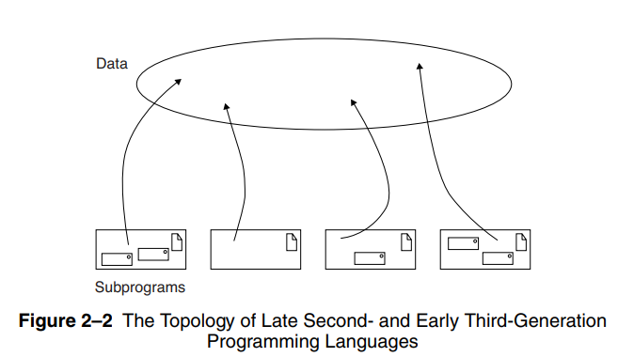
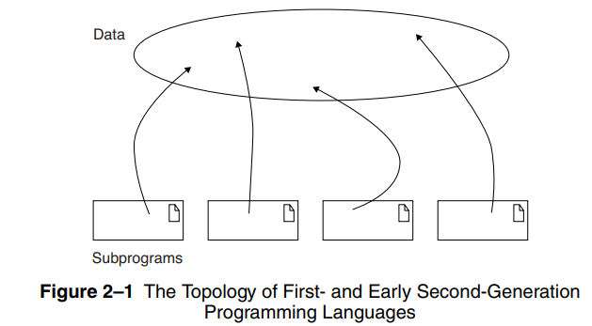
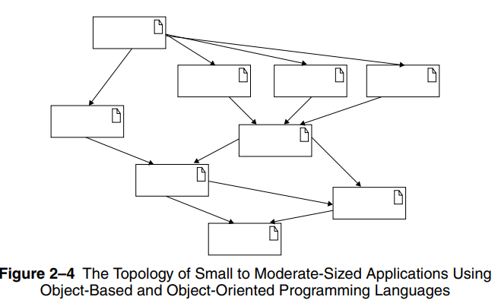
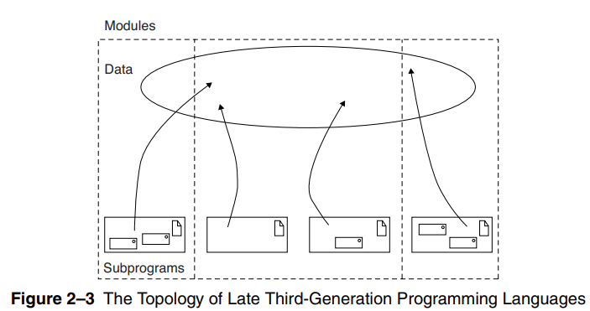
The Evolution of the Object Model
The Generations of Programming Languages

Slide 3
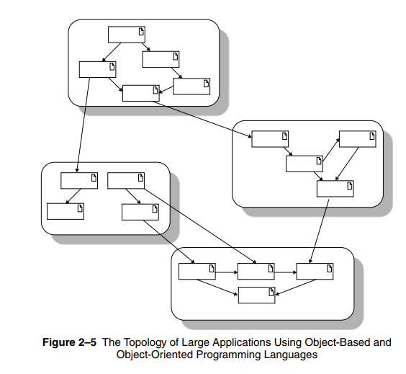

Slide 4
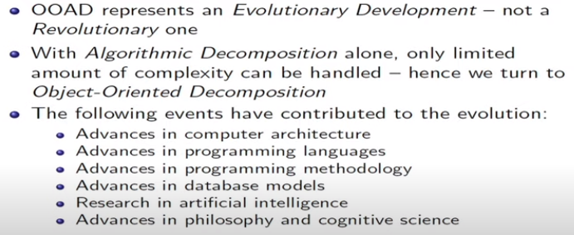
Foundations of the Object Models

Slide 5
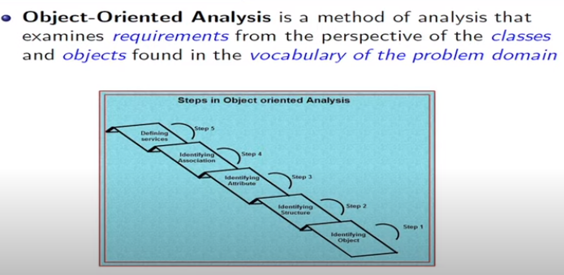
Object Oriented Analysis

Slide 6
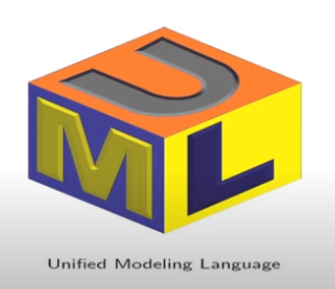
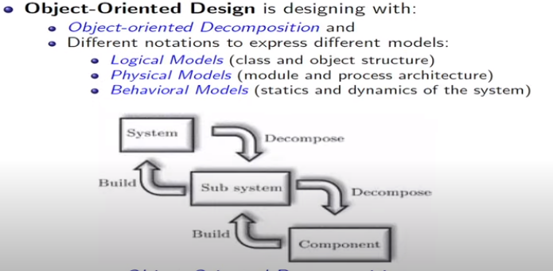
Object oriented design

Slide 7
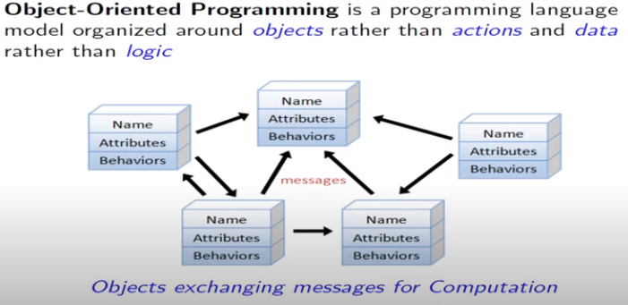
Object Oriented Programming

Slide 8
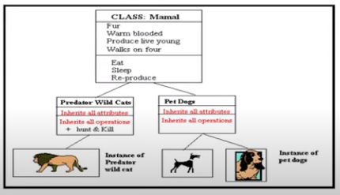
Object Oriented Programming
Object
Class [Type]
Inheritance

Slide 9
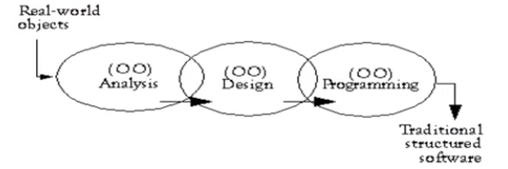
How OOA, OOD, OOP Related?

Slide 10
Elements of Object Model: Major
Abstraction
Encapsulation
Modularity
Hierarchy

